Slide 1
Elijah
1 Kings 19:9-13

Slide 2
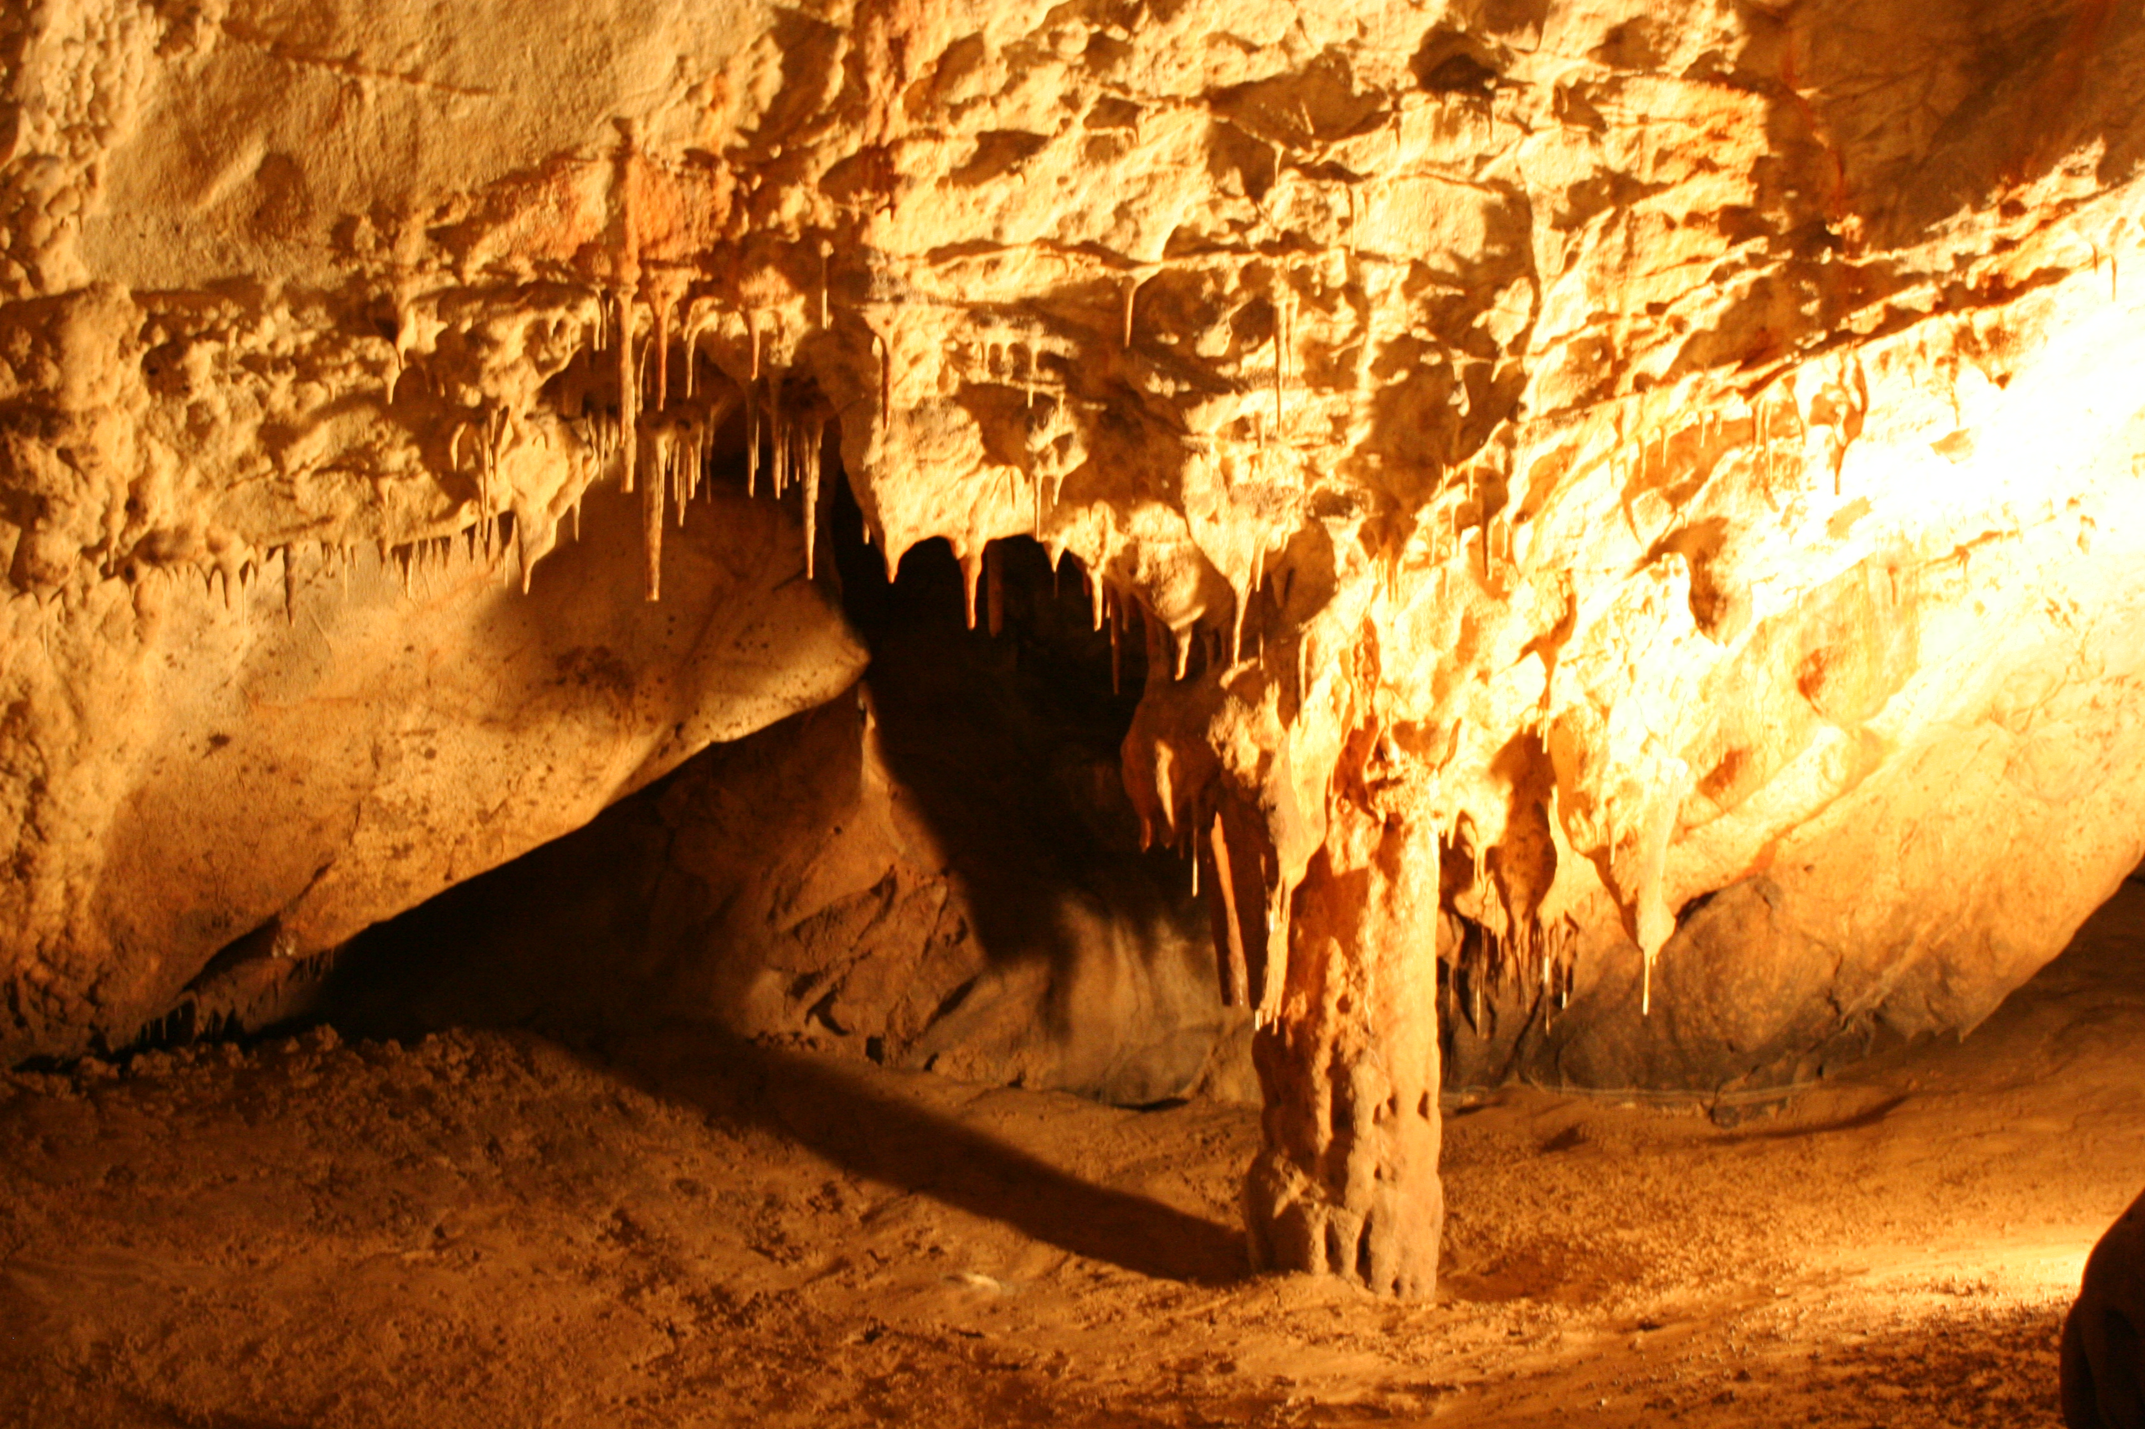
he came to a cave, where he took shelter. But the word of the LORD came to him: Why are you here, Elijah?
This Photo by Unknown Author is licensed under CC BY-SA
This Photo by Unknown Author is licensed under CC BY-SA

Slide 3
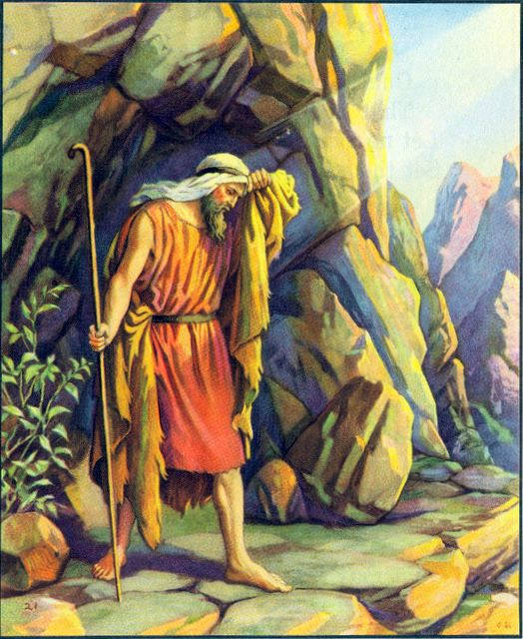
He answered: “I have been most zealous for the LORD, the God of hosts, but the Israelites have forsaken your covenant. They have destroyed your altars and murdered your prophets by the sword. I alone remain, and they seek to take my life.”
This Photo by Unknown Author is licensed under CC BY-NC

Slide 4
Then the LORD said: Go out and stand on the mountain before the LORD; the LORD will pass by.
This Photo by Unknown Author is licensed under CC BY-SA

Slide 5
There was a strong and violent wind rending the mountains and crushing rocks before the LORD—but the LORD was not in the wind;
This Photo by Unknown Author is licensed under CC BY-SA

Slide 6
after the wind, an earthquake—but the LORD was not in the earthquake;
This Photo by Unknown Author is licensed under CC BY-SA

Slide 7
after the earthquake, fire—but the LORD was not in the fire;
This Photo by Unknown Author is licensed under CC BY-SA

Slide 8
after the fire, a light silent sound

Slide 9
When he heard this, Elijah hid his face in his cloak and went out and stood at the entrance of the cave. A voice said to him, Why are you here, Elijah?
This Photo by Unknown Author is licensed under CC BY-SA

