Slide 1

versus
BEING a Catechist
WORKING AS a Catechist
BEING a Catechist vs. WORKING AS a Catechist — Sr. Patricia M. McCormack, IHM. EdD

Slide 2
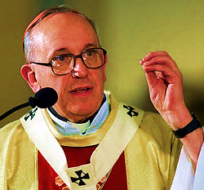
“Catechesis
is a vocation:
‘being
a catechist,’
this
is the vocation;
not
working as
a catechist.”
International Congress on Catechesis
September 27, 2013
BEING a Catechist vs. WORKING AS a Catechist — Sr. Patricia M. McCormack, IHM. EdD

Slide 3

Three-fold VOCATION of Catechist
2. Educator
1. Witness
3. Teacher
JPII, Redemptoris Missio #42v
BEING a Catechist vs. WORKING AS a Catechist — Sr. Patricia M. McCormack, IHM. EdD

Slide 4
Three-fold VOCATION of Catechist
1. Witness
BEING a Catechist vs. WORKING AS a Catechist — Sr. Patricia M. McCormack, IHM. EdD

Slide 5
1. ANIMATED WITNESS of the Faith
• Others observe that you have a personal relationship with Jesus and it sparks life within you.
• You exude vim, vigor, vitality, enthusiasm for Jesus, for others, for the mission of spreading the Gospel.
• Your energy attracts others. It brings light to darkness/confusion.
BEING a Catechist vs. WORKING AS a Catechist — Sr. Patricia M. McCormack, IHM. EdD

Slide 6
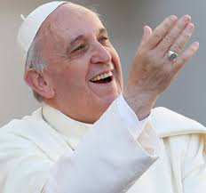
1. ANIMATED WITNESS of the Faith
ready smile
eye contact
spontaneous chat
non-defensive
twinkle in his eye
Animated Witness
speaks extemporaneously – in unrehearsed ways -- of the love and mercy of God
communicates love and it is infectious!
BEING a Catechist vs. WORKING AS a Catechist — Sr. Patricia M. McCormack, IHM. EdD

Slide 7

1. ANIMATED WITNESS of the Faith
• Never under-estimate the power of a smile.
• Initiate gestures of hospitality and welcome.
• Put a bounce in your step.
• Expend effort, energy, enthusiasm, dedication, commitment
• Witness Christian values.
• Display a patient, helpful attitude/approach.
• Be an agent of hope.
• Be respectful, confidential.
BEING a Catechist vs. WORKING AS a Catechist — Sr. Patricia M. McCormack, IHM. EdD

Slide 8


Exchange Thoughts . . .
Dyad
Triad
Quad
Articulate one practice that will increase
your ability to be
an ANIMATED WITNESS of the Faith.
BEING a Catechist vs. WORKING AS a Catechist — Sr. Patricia M. McCormack, IHM. EdD

Slide 9

BEING a Catechist vs. WORKING AS a Catechist — Sr. Patricia M. McCormack, IHM. EdD

Slide 10
Three-fold VOCATION of Catechist
2. Educator
BEING a Catechist vs. WORKING AS a Catechist — Sr. Patricia M. McCormack, IHM. EdD

Slide 11
EDUCATOR Mentor by sharing life experience
• “Walk the walk” through ages & stages.
BEING a Catechist vs. WORKING AS a Catechist — Sr. Patricia M. McCormack, IHM. EdD

Slide 12
 | STAGES OF FAITH | (James W. Fowler)
Primary School Grades K-1-2 | Stage 2 Mythic-Literal Faith | Story Stage
Intermediate School Grades 3-4-5
Middle School Grades 6-7-8 | Stage 3 Synthetic-Conventional Faith | Belonging Stage
High School Years
Adults | Stage 4 Individuative/Projective Faith | Searching Stage
 | Stage 5 Conjunctive Faith | Owned Faith
 | Stage 6 Universalizing Faith
BEING a Catechist vs. WORKING AS a Catechist — Sr. Patricia M. McCormack, IHM. EdD

Slide 13
EDUCATOR Mentor by sharing life experience
• Illustrate that “the faith” is a dynamic, lively process rather than a static condition.
• Demonstrate that “the faith” is a life-long, continual conversion to Jesus and growing in relationship with him.
BEING a Catechist vs. WORKING AS a Catechist — Sr. Patricia M. McCormack, IHM. EdD

Slide 14
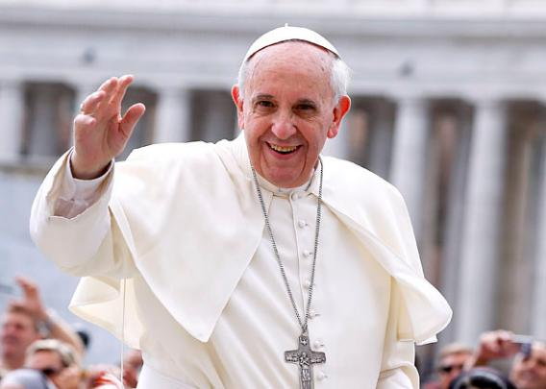
• We keep learning ways that Francis has: grown and changed over time, mistakes he has made; admission of personal sinfulness; how others have influenced him; how events have stretched his soul.
• Ease and familiarity with God (intimate relationship) is evident.
Educator
“Who am I to judge?”
• He speaks “we,” not “you.”
• He engages people whose views are different or who live apart from Church discipline.
BEING a Catechist vs. WORKING AS a Catechist — Sr. Patricia M. McCormack, IHM. EdD

Slide 15
• Trace the ways of grace in your lifeline.
• Let your speech convey that you are one with the listener – not above or apart from.
• Perform “moral miracles”… show love to parents/students who vex you… initiate, welcome, acknowledge, include, invite, respect, give second chances, ask advice, accommodate, forgive …
• Be a missionary of mercy.
• Testify to the difference God makes in your life.
• Share highlights of your faith development.
BEING a Catechist vs. WORKING AS a Catechist — Sr. Patricia M. McCormack, IHM. EdD

Slide 16
Exchange Thoughts . . .
Dyad
Triad
Quad
Share ONE “marker moment”
from your faith-history.
“Sometimes we do not know the value of a moment it becomes a memory.” (Dr. Seuss)
BEING a Catechist vs. WORKING AS a Catechist — Sr. Patricia M. McCormack, IHM. EdD

Slide 17
BEING a Catechist vs. WORKING AS a Catechist — Sr. Patricia M. McCormack, IHM. EdD

Slide 18
Three-fold VOCATION of Catechist
3. Teacher
BEING a Catechist vs. WORKING AS a Catechist — Sr. Patricia M. McCormack, IHM. EdD

Slide 19
3. EFFECTIVE TEACHER: Instructor of “the Faith”
• In culturally, age-appropriate ways transmit the Word of God from Scripture and Tradition.
• Know well and integrate content from the Catechism of the Catholic Church.
• Grasp that instruction will fall short if you are not primarily a WITNESS to Jesus and the joy of his Gospel.
BEING a Catechist vs. WORKING AS a Catechist — Sr. Patricia M. McCormack, IHM. EdD

Slide 20
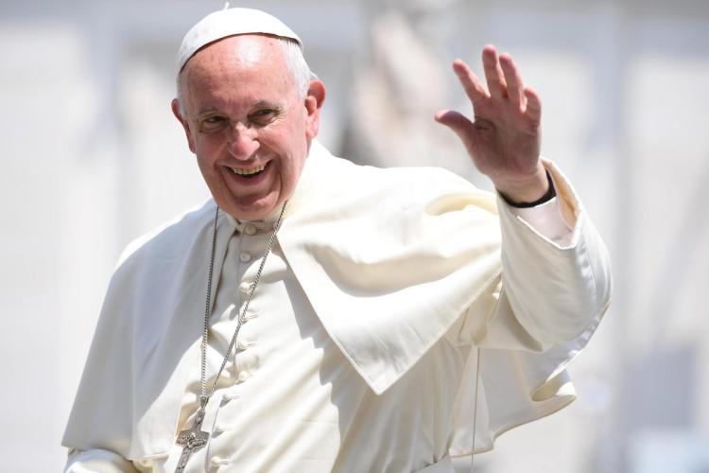
• Teaches from the heart.
• Speaks in uncomplicated ways.
• His messages are:
Clear
Succinct
Respectful
Teacher
In formal presentation and informal, impromptu conversation his message is grounded in Scripture, historical Church documents, directives of Vatican Council II or prescriptions of the Catechism of the Catholic Church.
BEING a Catechist vs. WORKING AS a Catechist — Sr. Patricia M. McCormack, IHM. EdD

Slide 21
• Refer to the Catechism of the Catholic Church when you plan a lesson.
• Publisher programs include teacher guide material. Study it and plan how to incorporate it into your lesson.
• Deliver information with a simple,
non-judgmental attitude.
• Speak from a prepared heart. Avoid reading material aloud.
• Speak to/with parents & students; not at them.
BEING a Catechist vs. WORKING AS a Catechist — Sr. Patricia M. McCormack, IHM. EdD

Slide 22
Exchange Thoughts . . .
Dyad
Triad
Quad
1. Who was the most effective catechist in your life experience?
2. What qualities did he/she demonstrate that made you want to learn from that person?
BEING a Catechist vs. WORKING AS a Catechist — Sr. Patricia M. McCormack, IHM. EdD

Slide 23
BEING a Catechist vs. WORKING AS a Catechist — Sr. Patricia M. McCormack, IHM. EdD

Slide 24
Three-fold VOCATION of Catechist
2. Educator
1. Witness
3. Teacher
JPII, Redemptoris Missio #42v
BEING a Catechist vs. WORKING AS a Catechist — Sr. Patricia M. McCormack, IHM. EdD

Slide 25
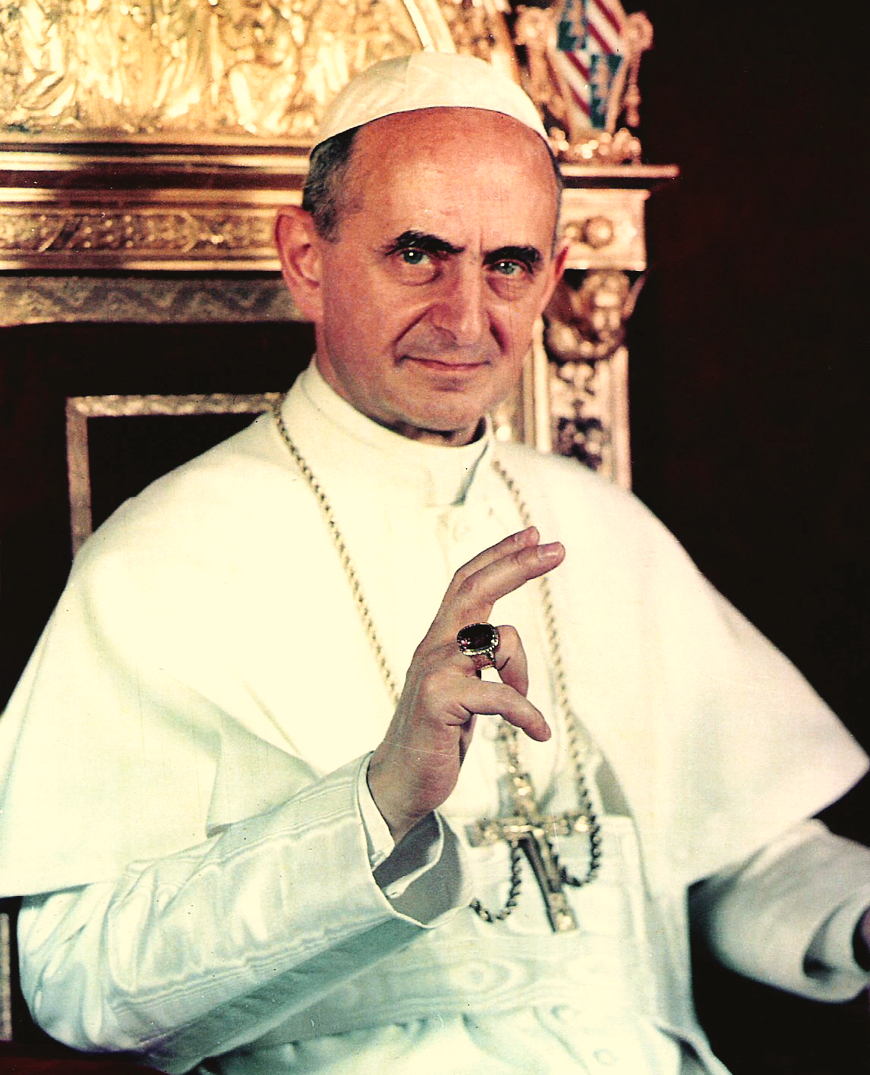
“The men of our day
are more impressed with witnesses
than by teachers,
and if they listen to these it is because
they also bear witness.”
Pope Paul VI
Evangelli Nuntiandi, #41
BEING a Catechist vs. WORKING AS a Catechist — Sr. Patricia M. McCormack, IHM. EdD

Slide 26
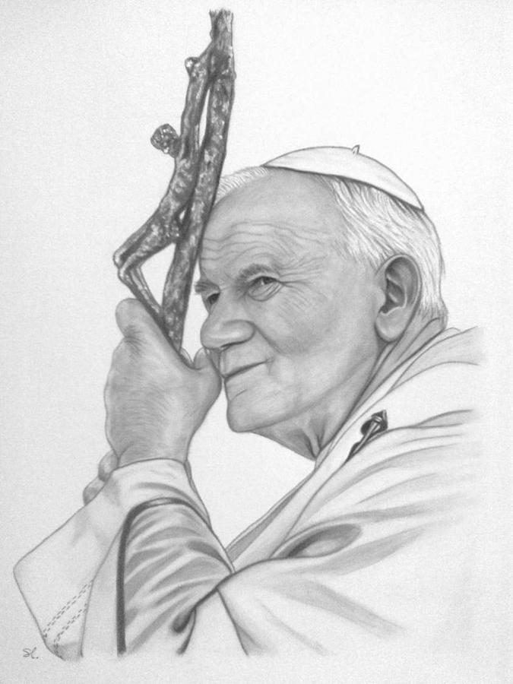
Redemptoris Missio, #42
“ People today
put more trust
in witnesses than in teachers,
in experience than in teaching,
and in life and action than in theories.”
BEING a Catechist vs. WORKING AS a Catechist — Sr. Patricia M. McCormack, IHM. EdD

Slide 27
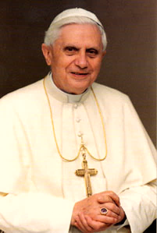
“The church does not grow by proselytizing; she grows
by attracting others.”
Mass at Conference of Latin American Bishops, 5/13/2007
BEING a Catechist vs. WORKING AS a Catechist — Sr. Patricia M. McCormack, IHM. EdD

Slide 28
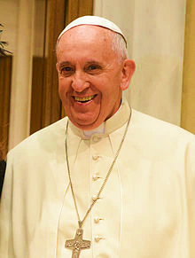
BEING A CATECHIST EMBRACES YOUR WHOLE LIFE.
“It means leading people to encounter Christ by our words and our lives, by giving witness.
… What attracts is our witness.
Being a catechist means
witnessing to the faith,
being consistent in our personal life . . .”
Audience to Catechists, 9/27/13
BEING a Catechist vs. WORKING AS a Catechist — Sr. Patricia M. McCormack, IHM. EdD

Slide 29
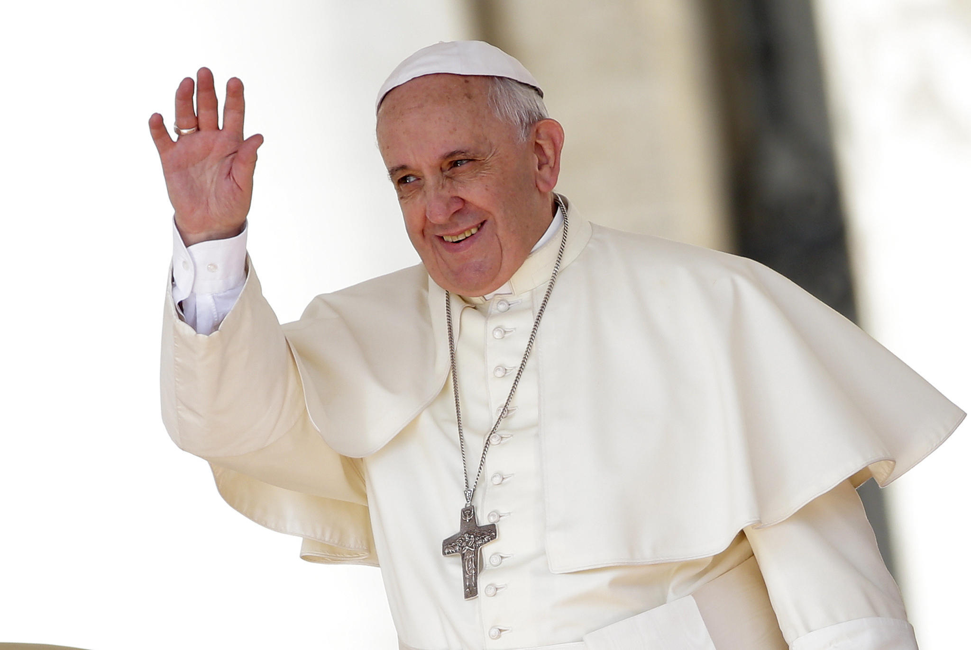
“We lead others to Jesus
with our words
and our lives,
with our witness.”
“People should see the Gospel, read the Gospel in our lives.”
Audience to Catechists, 9/27/13
BEING a Catechist vs. WORKING AS a Catechist — Sr. Patricia M. McCormack, IHM. EdD

Slide 30
Jesus, make us Agents of your Gospel.
If our lives have become shallow . . . | Deepen them.
If our principles have become clouded . . . | Focus them.
If our ideals have become tarnished . . . | Restore them.
If our hopes have become faded . . . | Revive them.
BEING a Catechist vs. WORKING AS a Catechist — Sr. Patricia M. McCormack, IHM. EdD

Slide 31
Jesus, make us Agents of your Gospel.
If our loyalties have grown dim . . . | Brighten them.
If our values have become confused . . . | Clarify them.
If our purposes have become blurred . . . | Sharpen them.
If our horizons have become narrowed . . . | Widen them.
BEING a Catechist vs. WORKING AS a Catechist — Sr. Patricia M. McCormack, IHM. EdD

Slide 32
The Renewal Prayer
is an adaptation of
“Beth Shir Shalom - English Readings for Shabbat Afternoon,” p. 23. www.bethshirshalom.org
BEING a Catechist vs. WORKING AS a Catechist — Sr. Patricia M. McCormack, IHM. EdD

Slide 33
Jesus, you call to my heart once more:
“Leave anything that holds you back
from deeper love. Come follow me.”
• Grant me the courage to leave behind whatever limits my effectiveness as an evangelizer.
BEING a Catechist vs. WORKING AS a Catechist — Sr. Patricia M. McCormack, IHM. EdD

Slide 34
• Empower me to be an animated witness, a mentor-educator, and an affective instructor.
• May my heart’s connection with you be so strong and true that I will daily risk the road of following in your footsteps to bring the Good News to all people. Amen.
BEING a Catechist vs. WORKING AS a Catechist — Sr. Patricia M. McCormack, IHM. EdD

Slide 35

WEBSITE
www.ParentTeacherSupport.org
Newsletters:
• Family Faith
• Character Development
• School Issues
• Religious Ed Classroom
• Family Dynamics
BEING a Catechist vs. WORKING AS a Catechist — Sr. Patricia M. McCormack, IHM. EdD

Slide 36
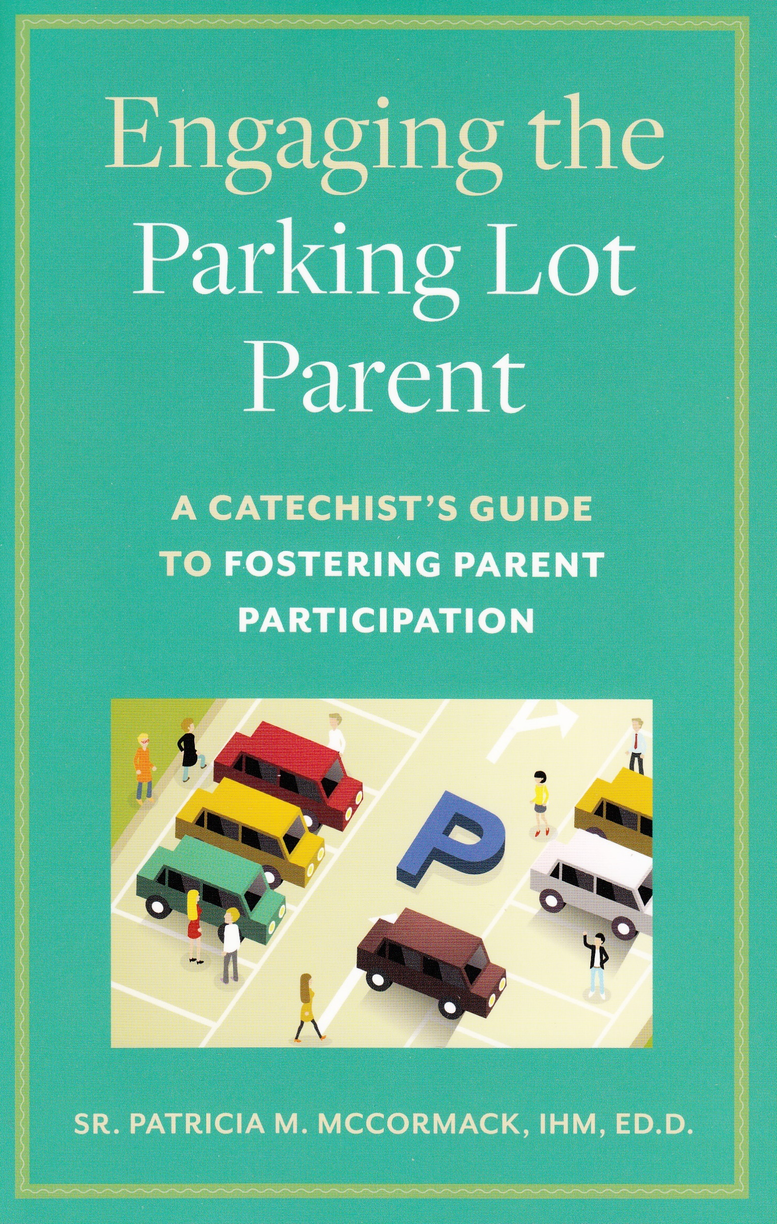

BEING a Catechist vs. WORKING AS a Catechist — Sr. Patricia M. McCormack, IHM. EdD

Slide 37
IHM Formative Support For Parents & Teachers
Dr. Patricia M. McCormack, IHM
6328 Buist Avenue
Philadelphia, PA 19142
703-237-2891
DrPatMcCormack@aol.com
www.ParentTeacherSupport.org

Slide 38
versus
BEING a Catechist
WORKING AS a Catechist
BEING a Catechist vs. WORKING AS a Catechist — Sr. Patricia M. McCormark, IHM. EdD

